Slide 1


Hotien Huang
2024.05.28

Slide 2

Outline
Executive Summary
Introduction
Methodology
Results
Conclusion
Appendix

Slide 3
Executive Summary
Summary of methodologies
- Data Collection through API
- Data Collection with Web Scraping
- Data Wrangling
- Exploratory Data Analysis with SQL
- Exploratory Data Analysis with Data Visualization
- Interactive Visual Analytics with Folium
- Machine Learning Prediction
Summary of all results
- Exploratory Data Analysis result
- Interactive analytics in screenshots
- Predictive Analytics result

Slide 4
Introduction
Project background
Space X has best pricing ($62million, others $165million USD)
Largely due to ability to recover part of rocket (Stage 1)
- Space Y company wants to compete with Space X
Problems
- In order to reuse the part of rocket, Space Y has to training model to analysis the key factor lead success

Slide 5

Section 1

Slide 6
Methodology
Executive Summary
Data collection methodology:
SpaceX Data collected from 2 resources
- SpaceX API (https://api.spacexdata.com/v4/rockets/)
- Web Scraping (Wikipedia)
Perform data wrangling
Collected data was enriched by creating a landing outcome label based on outcome data after summarizing and analyzing features

Slide 7
Methodology
Executive Summary
Perform exploratory data analysis (EDA) using visualization and SQL
Perform interactive visual analytics using Folium and Plotly Dash
Perform predictive analysis using classification models
Data that was collected until this step were normalized, divided in training and test data sets and evaluated by four different classification models, being the accuracy of each model evaluated using different combinations of parameters.

Slide 8
Data Collection
How data sets were collected
Datasets were collected from SpaceX API (https://api.spacexdata.com/v4/rockets/)
Wikipedia (https://en.wikipedia.org/wiki/List_of_Falcon/_9/_and_Falcon_Heavy_launches), using web scraping technics.

Slide 9
Data Collection – SpaceX API
Request API parse the SpaceX launch data
SpaceX offers a public API from where data can be obtained and then used;
This API was used according to the flowchart beside and then data is persisted.
GitHub URL of the completed SpaceX API calls notebook： https://github.com/TonyHuang1688/Course10_Final_Assignment/blob/31ffd71676cef768ca95400d042e92de2859bdf3/Week1%20spacex-data-collection-api.ipynb
Filter data to only include Falcon 9 launches
Deal with Missing Data

Slide 10
Data Collection - Scraping
Request the Falcon9 Launch Wiki page
• Data from SpaceX launches can also be obtained from Wikipedia;
• Data are downloaded from Wikipedia according to the flowchart and then persisted.
GitHub URL of the completed web scraping notebook： https://github.com/TonyHuang1688/Course10_Final_Assignment/blob/31ffd71676cef768ca95400d042e92de2859bdf3/Week1%20spacex-data-collection-api.ipynb
Extract all column/variable names from HTML table header
Create a data frame by parsing the launch HTML tables

Slide 11
Data Wrangling
Exploratory Data Analysis(EDA)
Initially some Exploratory Data Analysis (EDA) was performed on the dataset.
Then the summary launches per site, occurrences of each orbit and occurrences of mission outcome per orbit type were calculated.
Finally, the landing outcome label was created from Outcome column.
GitHub URL of the completed data wrangling related notebooks：https://github.com/TonyHuang1688/Course10_Final_Assignment/blob/31ffd71676cef768ca95400d042e92de2859bdf3/Week1%20spacex-Data%20wrangling.ipynb
Summarizations
Creation of Landing Outcome Label

Slide 12
EDA with Data Visualization
Scatter Point Chart：It can intuitively display the relationship between two variables, especially numerical variables.
TASK 1: Visualize the relationship between Flight Number and Launch Site
TASK 2: Visualize the relationship between Payload and Launch Site
TASK 4: Visualize the relationship between FlightNumber and Orbit type
TASK 5: Visualize the relationship between Payload and Orbit type
Bar Chart：Suitable for displaying comparisons between different categories, clearly showing the differences in values.
TASK 3: Visualize the relationship between success rate of each orbit type
Line Plot：Suitable for displaying time series data or trends over time.
TASK 6: Visualize the launch success yearly trend
Categorical Columns：Can be combined with various chart types such as bar charts and pie charts.
TASK 7: Create dummy variables to categorical columns
TASK 8: Cast all numeric columns to float64
GitHub URL of the completed EDA with data visualization notebook： https://github.com/TonyHuang1688/Course10_Final_Assignment/blob/31ffd71676cef768ca95400d042e92de2859bdf3/Week2%20edadataviz.ipynb

Slide 13
EDA with SQL
To explore data, scatterplots and bar plots were used to visualize the relationship between pair of features:
Payload Mass X Flight Number, Launch Site X Flight Number, Launch Site X Payload Mass, Orbit and Flight Number, Payload and Orbit
GitHub URL of the completed EDA with SQL notebook：https://github.com/TonyHuang1688/Course10_Final_Assignment/blob/35e77e90ab3f14b649d68258a4215f8d1150ba92/Week2%20eda-sql-coursera_sqllite.ipynb

Slide 14
Build an Interactive Map with Folium
Markers, circles, lines and marker clusters were used with Folium Maps
Markers indicate points like launch sites;
Circles indicate highlighted areas around specific coordinates, like NASA Johnson Space Center;
Marker clusters indicates groups of events in each coordinate, like launches in a launch site; and
Lines are used to indicate distances between two coordinates.
GitHub URL of the completed interactive map with Folium map：https://github.com/TonyHuang1688/Course10_Final_Assignment/blob/35e77e90ab3f14b649d68258a4215f8d1150ba92/Week3%20launch_site_location.ipynb

Slide 15
Build a Dashboard with Plotly Dash
We built an interactive dashboard with Plotly dash
We plotted pie charts showing the total launches by a certain sites
We plotted scatter graph showing the relationship with Outcome and Payload Mass (Kg) for the different booster version.
GitHub URL of the completed Plotly Dash lab：https://github.com/TonyHuang1688/Course10_Final_Assignment/blob/35e77e90ab3f14b649d68258a4215f8d1150ba92/Week3%20spacex_dash_app.py

Slide 16
Predictive Analysis (Classification)
We loaded the data using numpy and pandas, transformed the data, split our data into training and testing.
We built different machine learning models and tune different hyperparameters using GridSearchCV.
We used accuracy as the metric for our model, improved the model using feature engineering and algorithm tuning.
We found the best performing classification model.
GitHub URL of the completed predictive analysis lab：https://github.com/TonyHuang1688/Course10_Final_Assignment/blob/35e77e90ab3f14b649d68258a4215f8d1150ba92/Week4%20SpaceX_Machine%20Learning%20Prediction.ipynb

Slide 17
Results
Exploratory data analysis results
Space X uses 4 different launch sites;
The first launches were done to Space X itself and NASA;
The average payload of F9 v1.1 booster is 2,928 kg;
The first success landing outcome happened in 2015 fiver year after the first launch;
Many Falcon 9 booster versions were successful at landing in drone ships having payload above the average;
Almost 100% of mission outcomes were successful;
Two booster versions failed at landing in drone ships in 2015: F9 v1.1 B1012 and F9 v1.1 B1015;
The number of landing outcomes became as better as years passed.

Slide 18
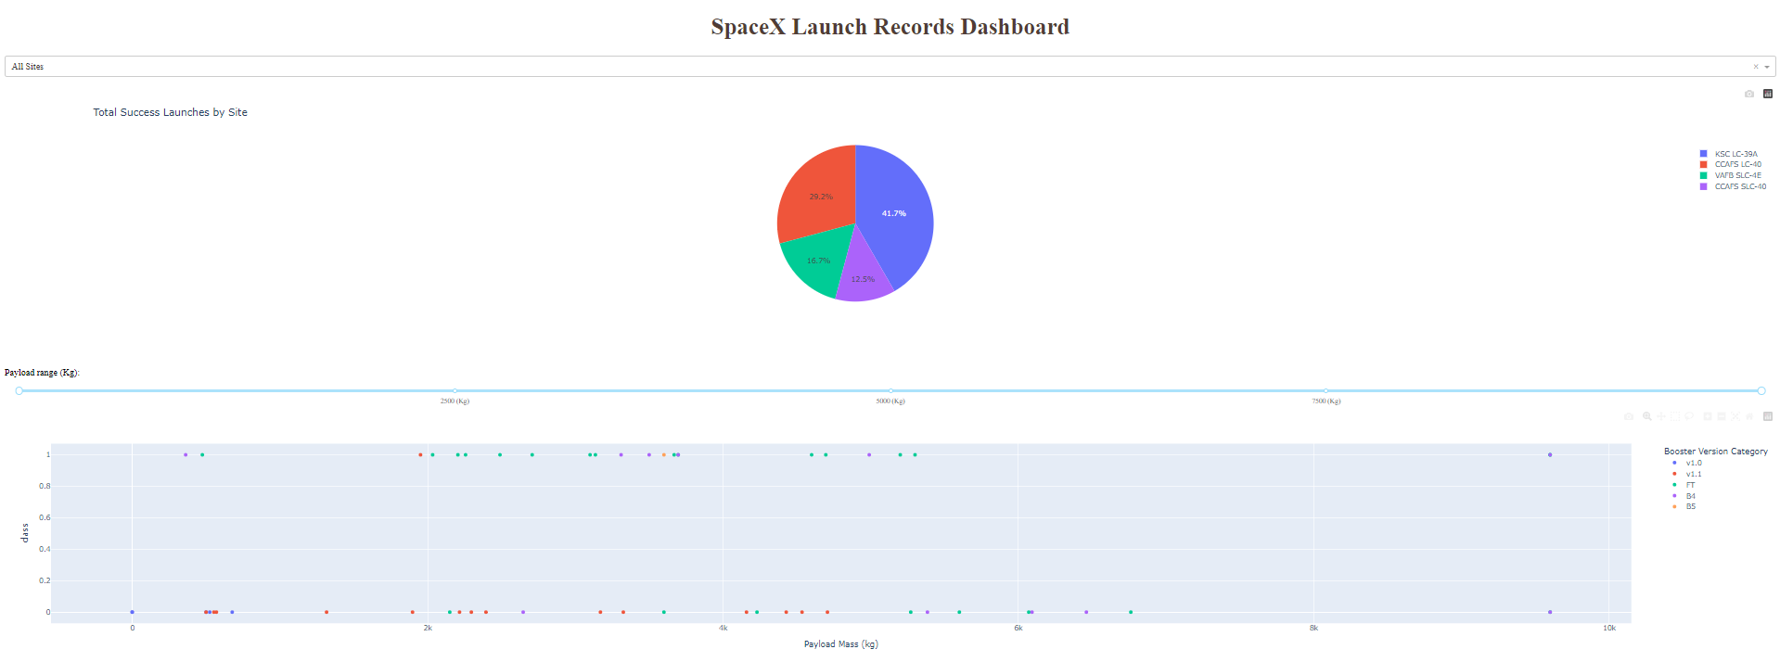
Results
This is a preview of the Plotly dashboard. The following sides will show the results of EDA with visualization, EDA with SQL, Interactive Map with Folium, and finally the results of our model with about 83% accuracy.

Slide 19

Section 2

Slide 20
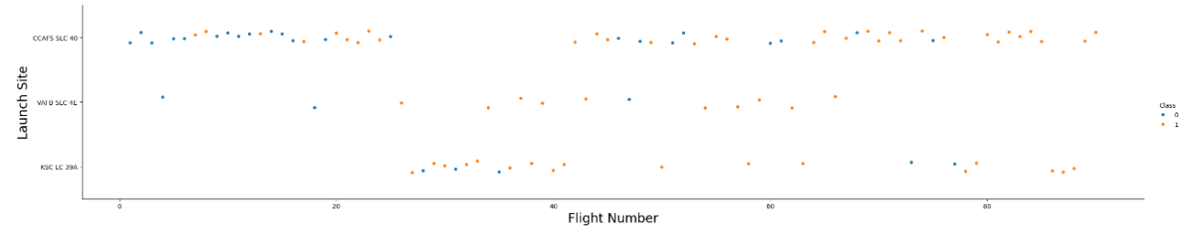
Flight Number vs. Launch Site
From the plot, we found that the larger the flight amount at a launch site, the greater the success rate at a launch site.

Slide 21
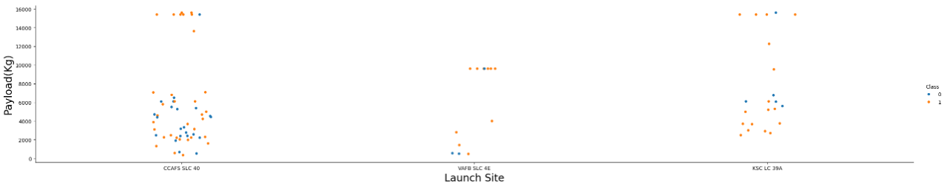
Payload vs. Launch Site
The greater the payload mass for launch site CCAFS SLC 40 the higher the success rate for the rocket.

Slide 22
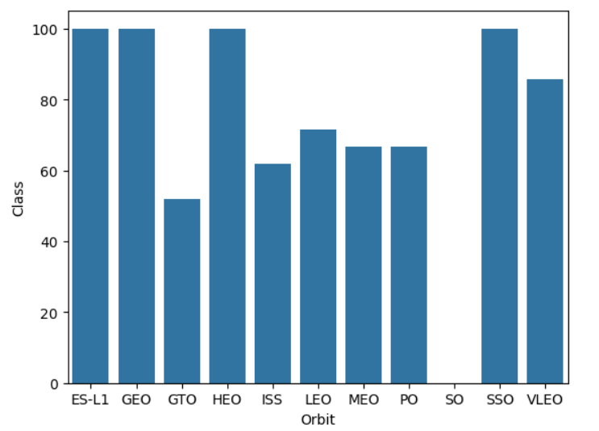
Success Rate vs. Orbit Type
From the plot, we can see that ES-L1, GEO, HEO, SSO, VLEO had the most rate.

Slide 23
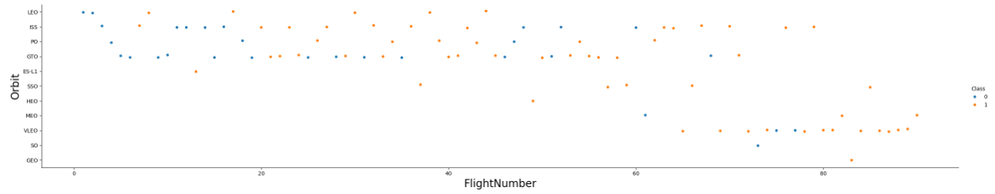
Flight Number vs. Orbit Type
The plot below shows the Flight Number vs. Orbit type. We observe that in the LEO orbit, success is related to the number of flights whereas in the GTO orbit, there is no relationship between flight number and the orbit.

Slide 24
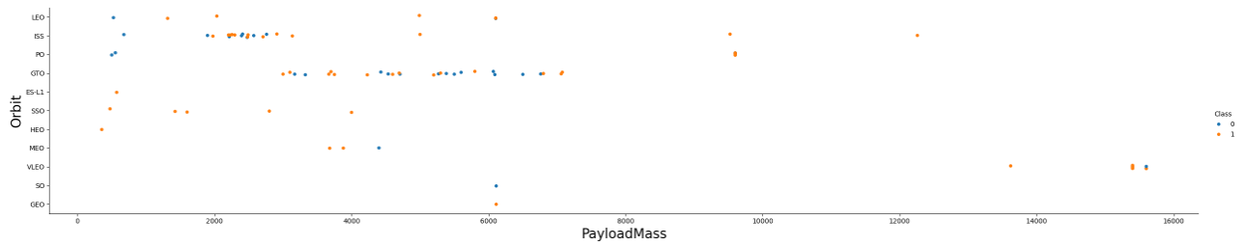
Payload vs. Orbit Type
We can observe that with heavy payloads, the successful landing are more for PO, LEO and ISS orbits.

Slide 25
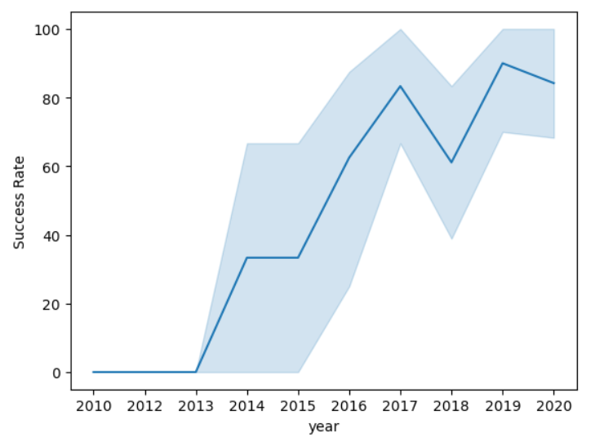
Launch Success Yearly Trend
From the plot, we can observe that success rate since 2013 kept on increasing till 2020.

Slide 26
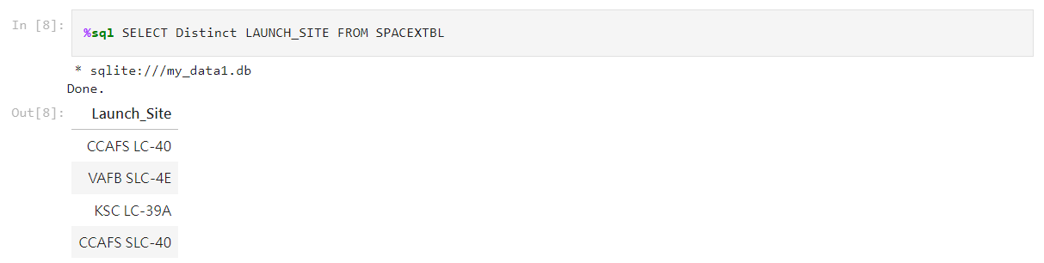
All Launch Site Names
We used the key word DISTINCT to show only unique launch sites from the SpaceX data.

Slide 27
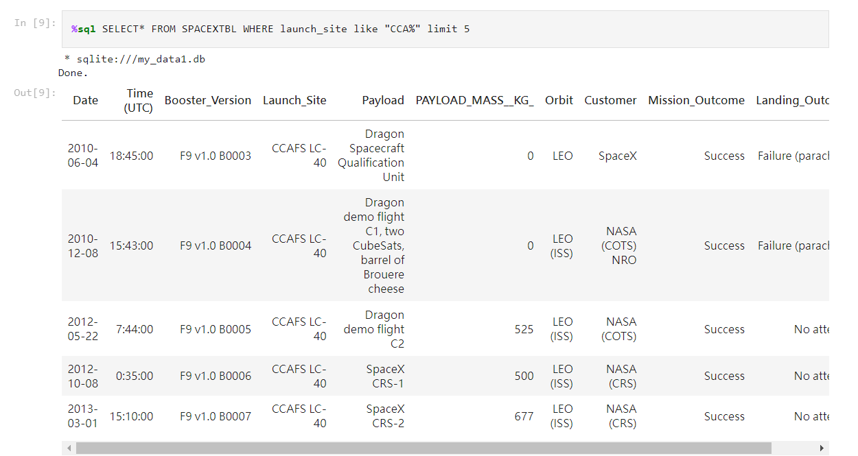
Launch Site Names Begin with 'CCA'
We used the query above to display 5 records where launch sites like `CCA%`

Slide 28
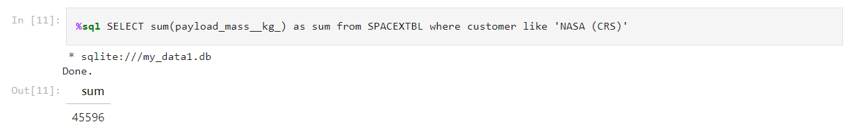
Total Payload Mass
We calculated the total payload carried by boosters from NASA as 45596 using the query below

Slide 29
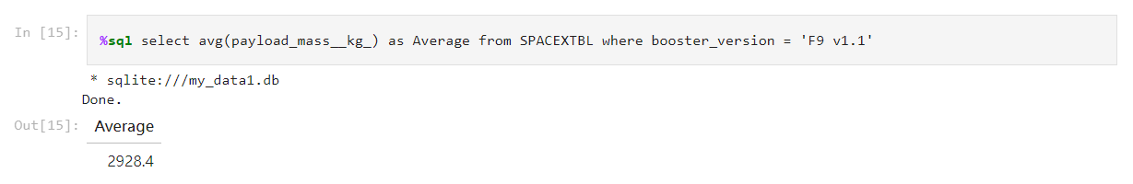
Average Payload Mass by F9 v1.1
We calculated the average payload mass carried by booster version F9 v1.1 as 2928.4

Slide 30
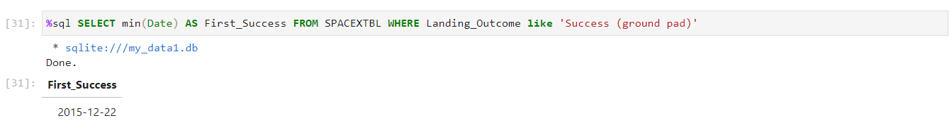
First Successful Ground Landing Date
We observed that the dates of the first successful landing outcome on ground pad was 22nd December 2015

Slide 31
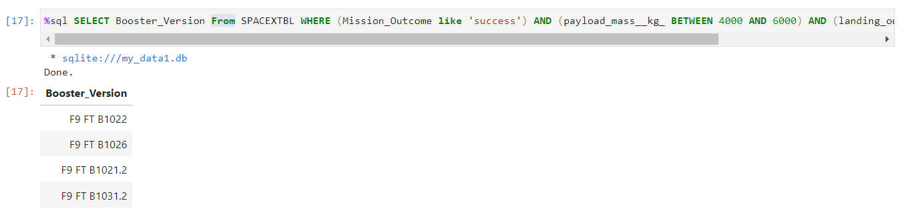
Successful Drone Ship Landing with Payload between 4000 and 6000
We used the WHERE clause to filter for boosters which have successfully landed on drone ship and applied the AND condition to determine successful landing with payload mass greater than 4000 but less than 6000

Slide 32
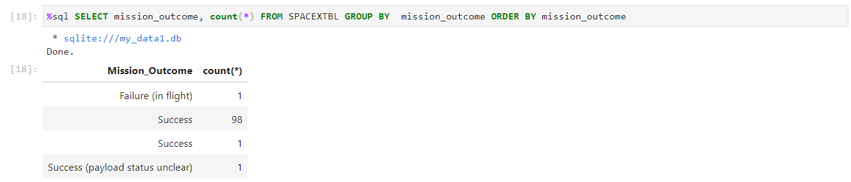
Total Number of Successful and Failure Mission Outcomes
We used “Count” and “Group BY” to filter for WHERE MissionOutcome was a success or a failure.

Slide 33
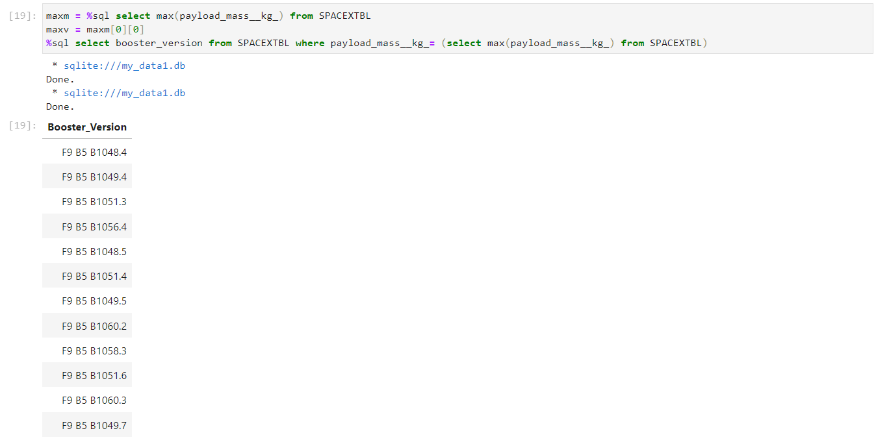
Boosters Carried Maximum Payload
We determined the booster that have carried the maximum payload using a subquery in the WHERE clause and the MAX() function.

Slide 34
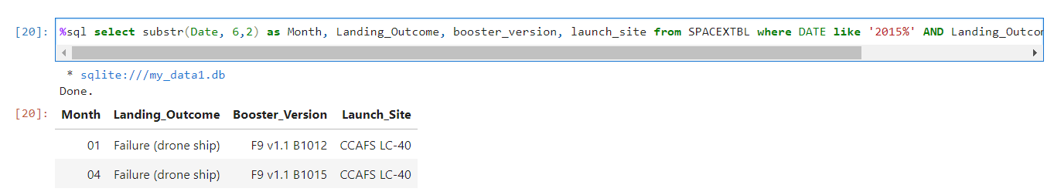
2015 Launch Records
We used a combinations of the WHERE clause, LIKE, AND, and BETWEEN conditions to filter for failed landing outcomes in drone ship, their booster versions, and launch site names for year 2015

Slide 35
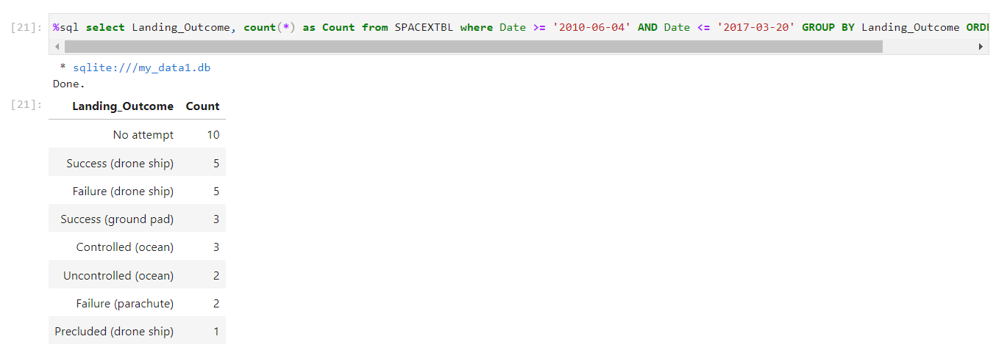
Rank Landing Outcomes Between 2010-06-04 and 2017-03-20
We selected Landing outcomes and the COUNT of landing outcomes from the data and used the WHERE clause to filter for landing outcomes BETWEEN 2010-06-04 to 2010-03-20.
We applied the GROUP BY clause to group the landing outcomes and the ORDER BY clause to order the grouped landing outcome in descending order.

Slide 36

Section 3

Slide 37
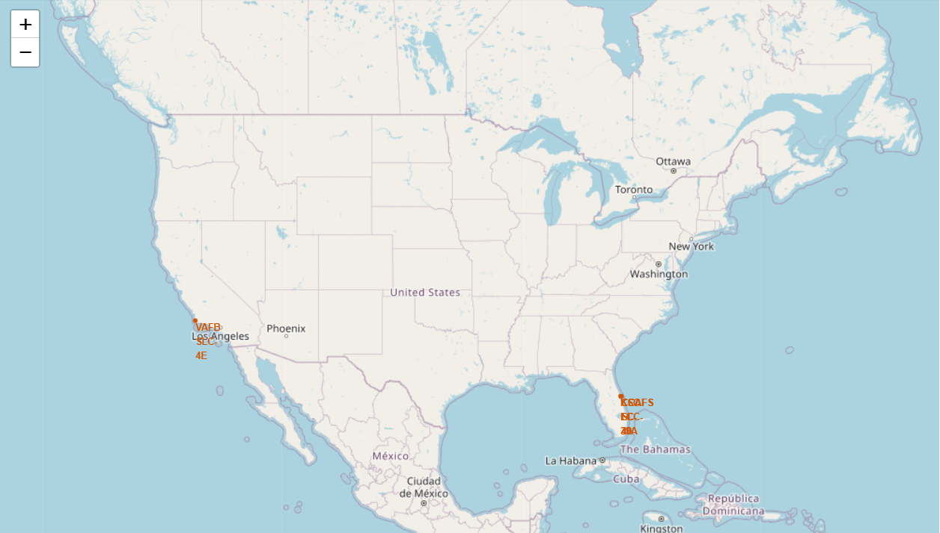
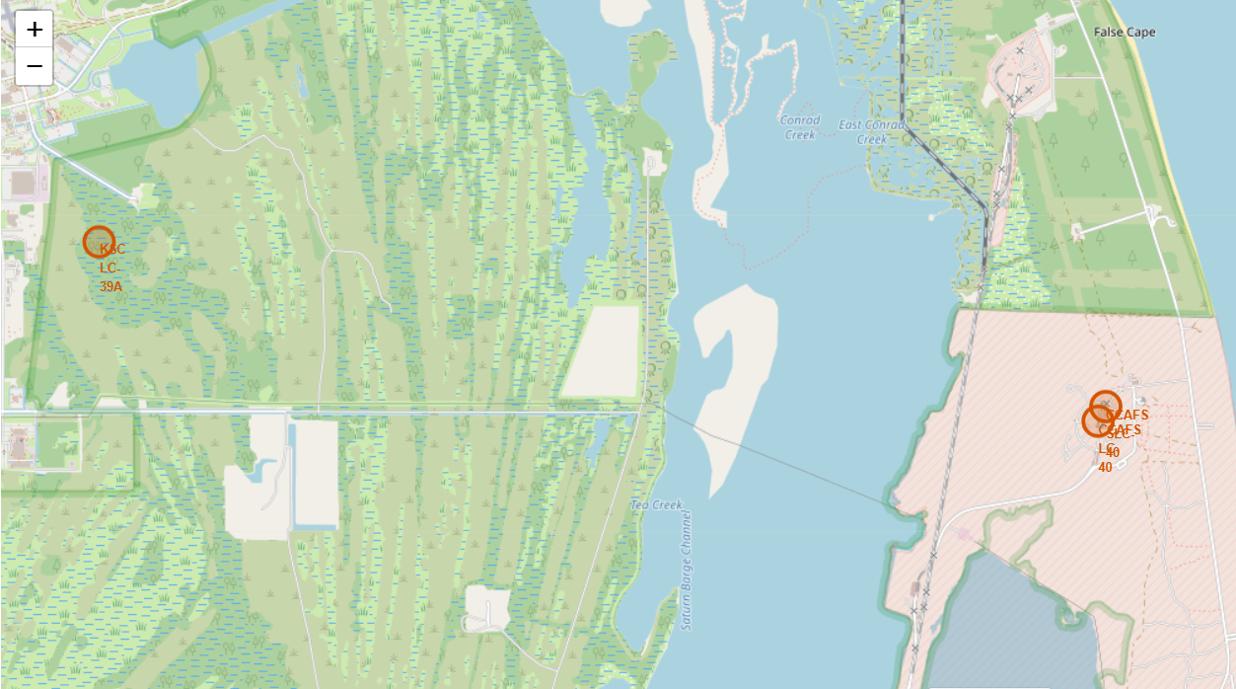
Launch Site Locations
We can see the launch sites are located in the coast of America

Slide 38
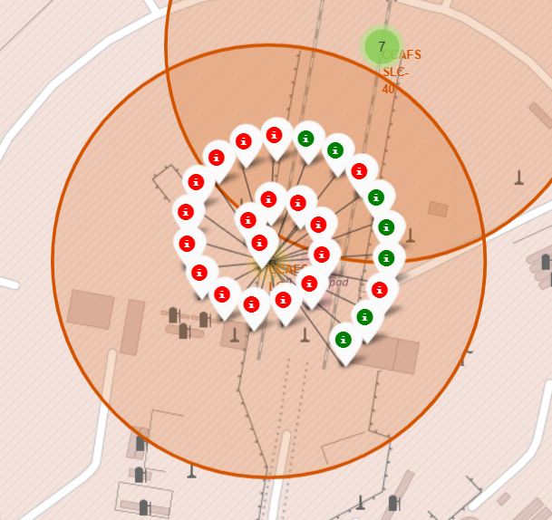
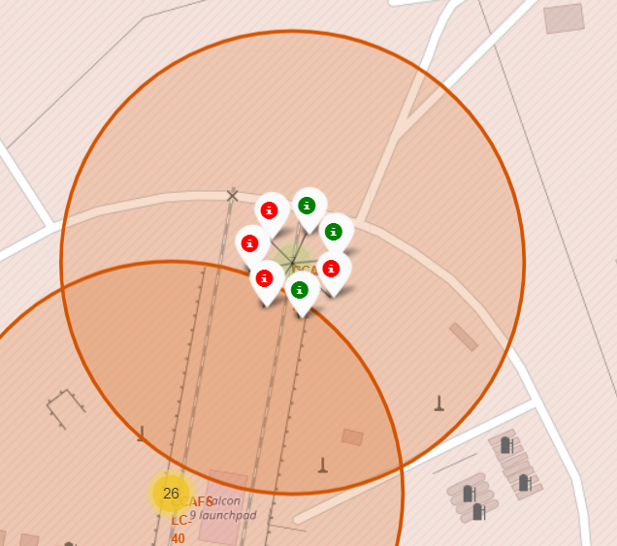
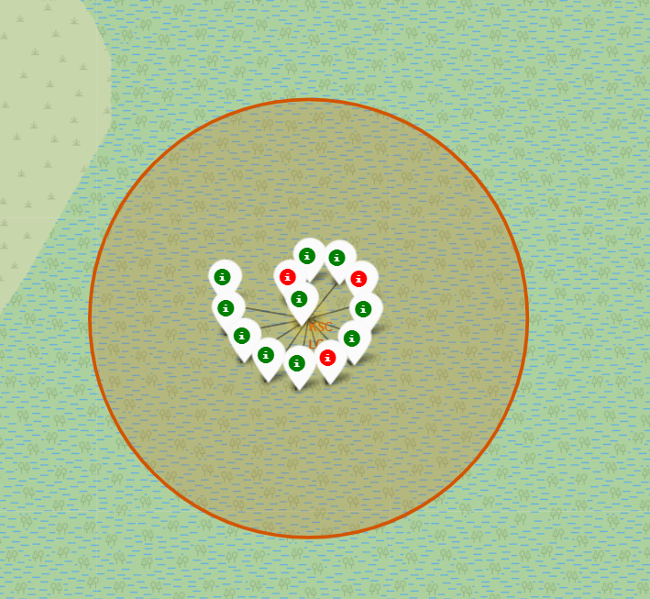
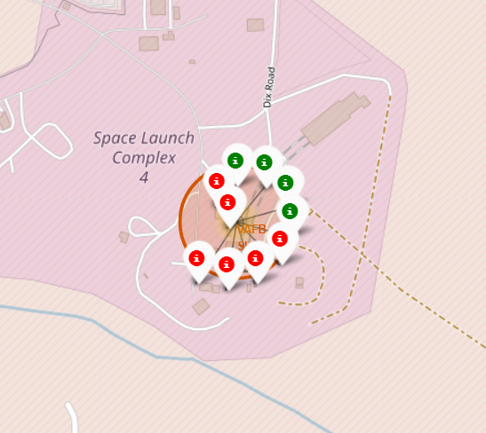
Markers showing launch sites with color labels
Green Marker shows successful launches, and red marker shows failure.
CCAFS LC-40
CCAFS SLC-40
KSC LC-39A
VAFB SLC-4E
FLORIDA
California

Slide 39
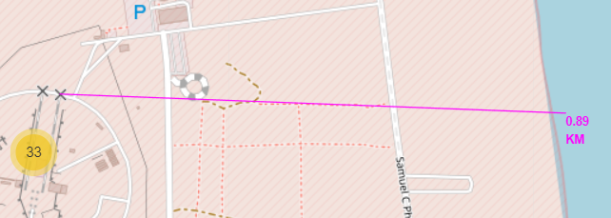
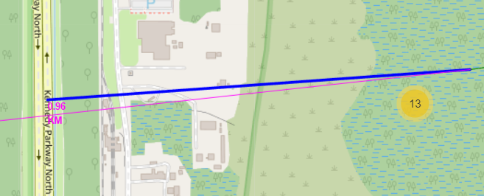
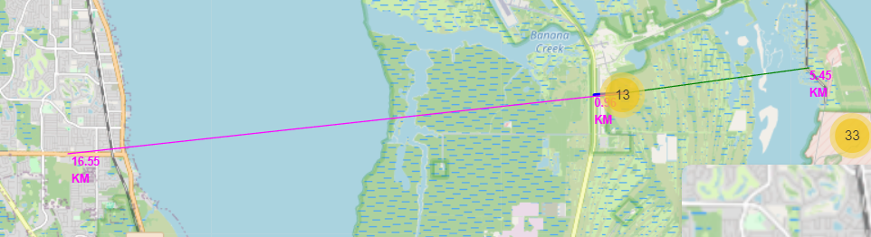
Launch Site distance to landmarks
To the coast：0.89km
To highway：0.96km
To the city：16.55km
To railway：5.45km

Slide 40

Section 4

Slide 41
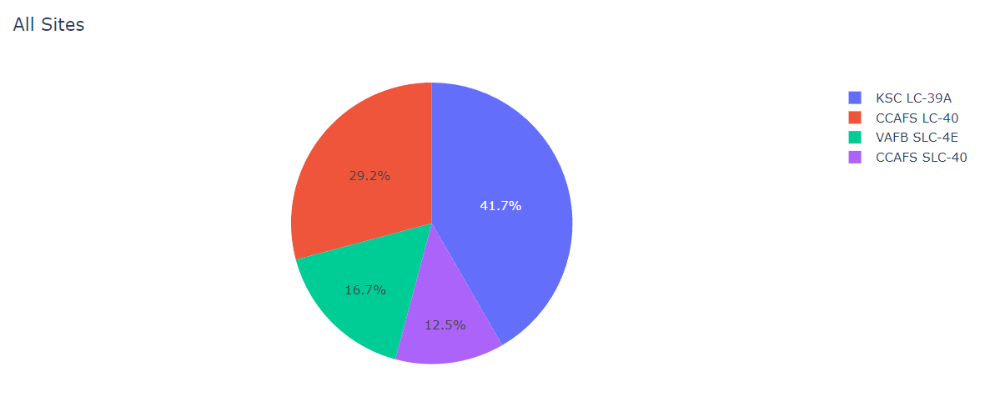
The success percentage achieved by each launch site
KSC LC-39A had the most successful launches

Slide 42
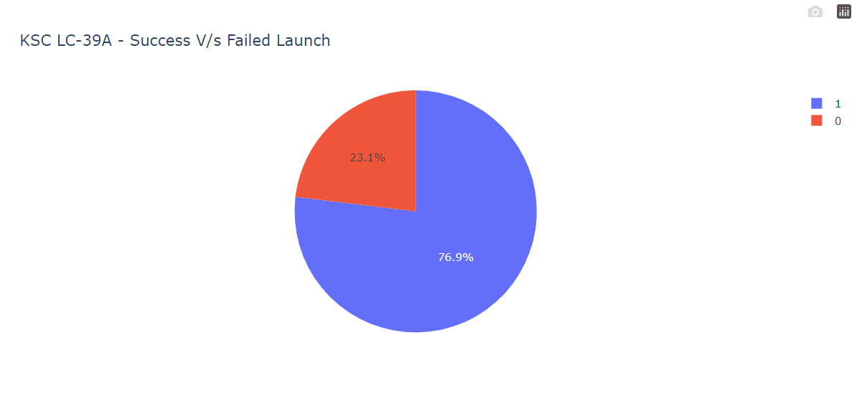
Launch site with the highest launch success ratio
KSC LC-39A Success rate reached 76.9%

Slide 43
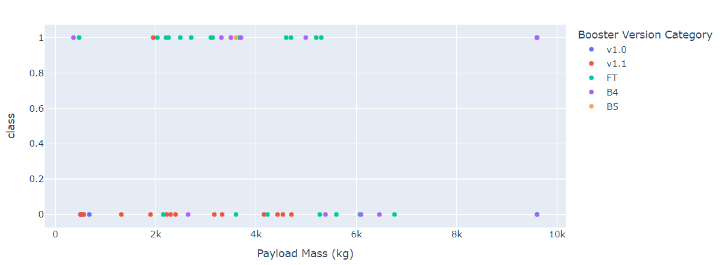
Payload vs Launch Outcome for all sites, with different payload selected in the range slider
We can see the payload weight under 4000kg had higher success rate than which payload is over 4000kg.

Slide 44

Section 5

Slide 45
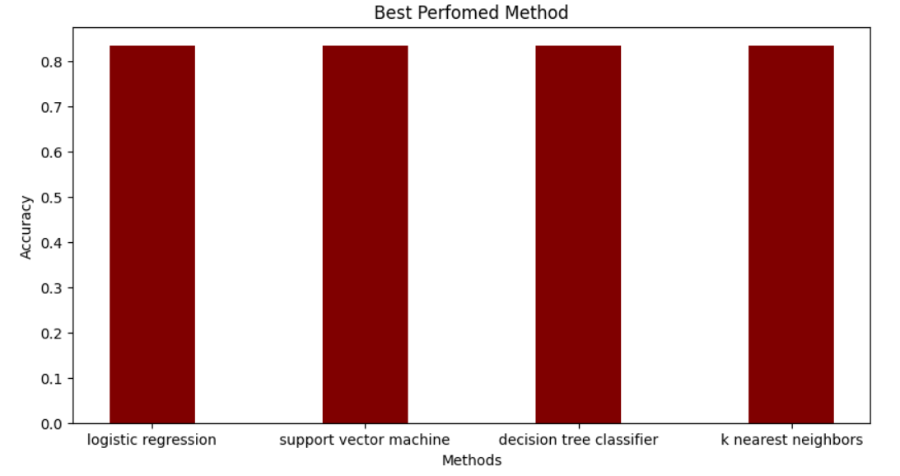
Classification Accuracy
All models had virtually the same accuracy on the test set at 83.33% accuracy.

Slide 46
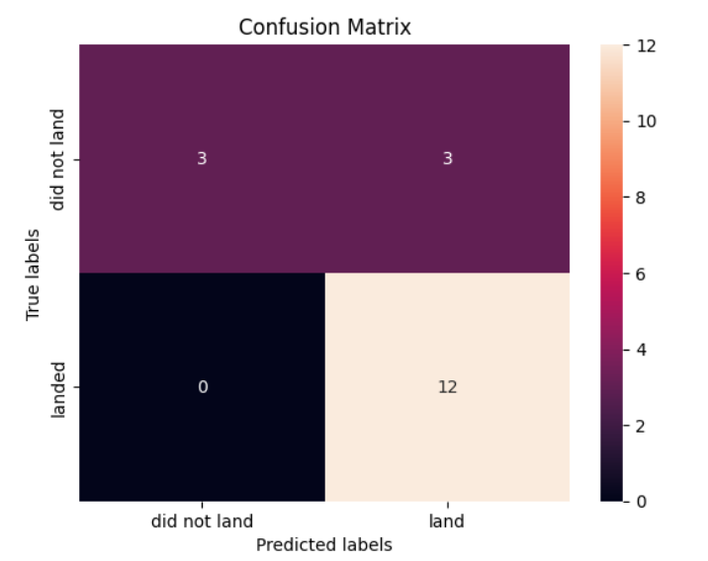
Confusion Matrix
All models had same result in confusion matrix.
TP(True Positive)：12
TF(False Positive)：0
TN (True Negative)：3
FN(False Negative)：3

Slide 47
Conclusions
We can conclude that:
The larger the flight amount at a launch site, the greater the success rate at a launch site.
Launch success rate started to increase in 2013 till 2020.
Orbits ES-L1, GEO, HEO, SSO, VLEO had the most success rate.
KSC LC-39A had the most successful launches of any sites.
The machine learning algorithm are same accuracy for this task.

Slide 48
Appendix
GitHub repository url：
https://github.com/TonyHuang1688/Course10_Final_Assignment.git

Slide 49


